Slide 1
SQL MURDER MISTRY
Can you find out whodunnit?

Slide 2
Murder Description
A crime has taken place and the detective needs your help. The detective gave you the crime scene report, but you somehow lost it. You vaguely remember that the crime was a ​murder​ that occurred sometime on ​Jan.15, 2018​ and that it took place in ​SQL City​. Start by retrieving the corresponding crime scene report from the police department’s database.

Slide 3
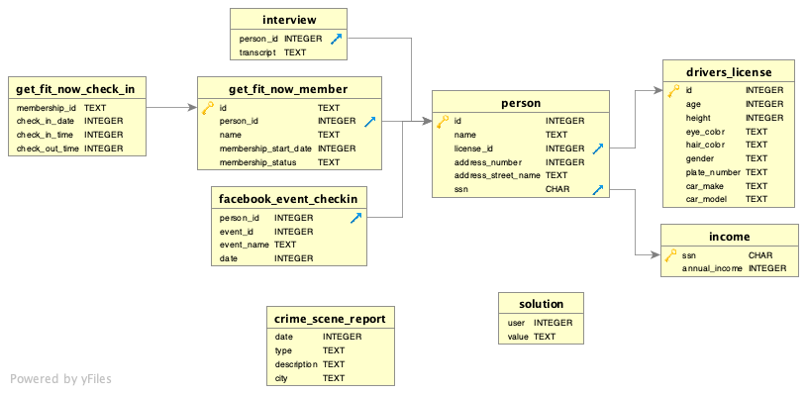
SCHEMA

Slide 4
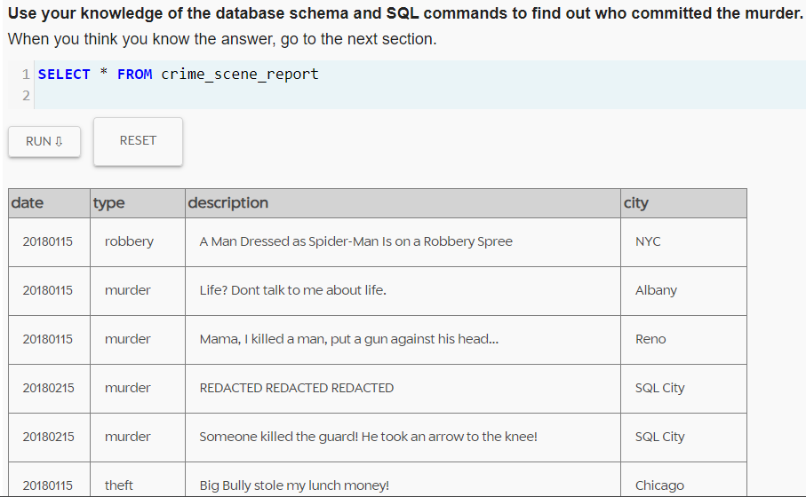
Checking the Crime Scene Report

Slide 5
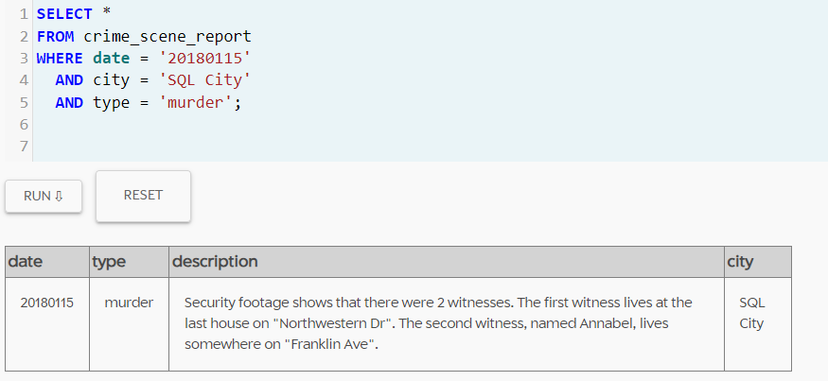
2 Witnesses:
1) The first witness lives at the last house on "Northwestern Dr“.
2) The second witness, named Annabel, lives somewhere on "Franklin Ave“.

Slide 6
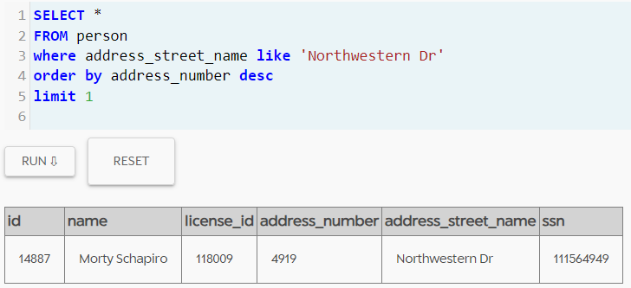
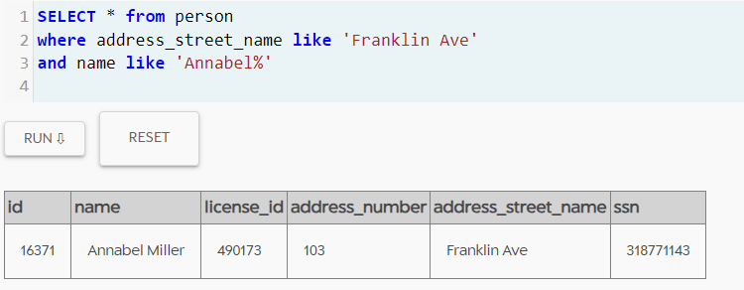
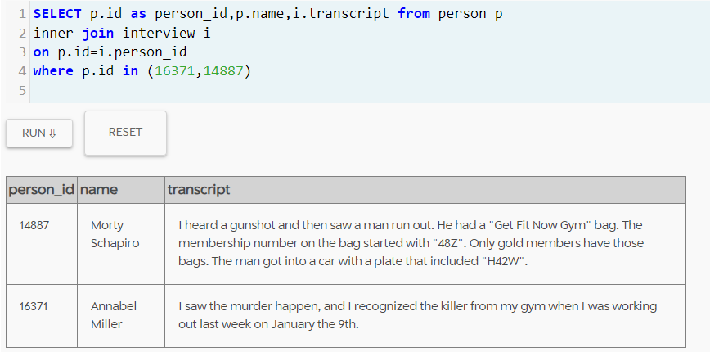
Witness 1
Witness 2
Looking for the statements given by 2 witnesses in the Interview table!

Slide 7
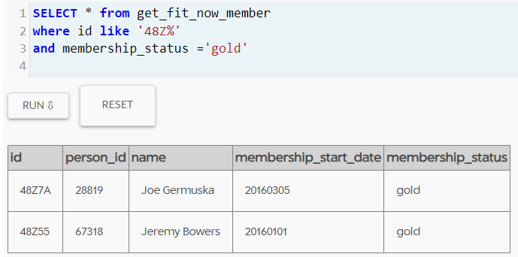
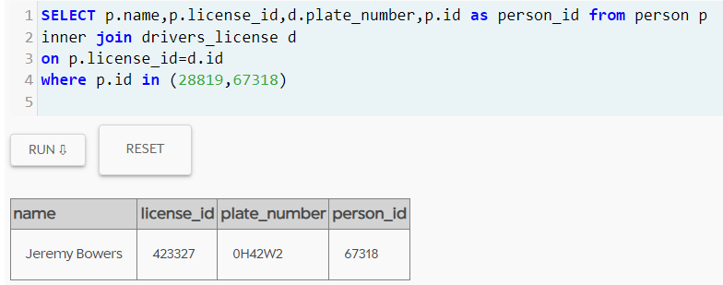
Witness Name | Interview Statement
Annabel Miller | I saw the murder happen, and I recognized the killer from my gym when I was working out last week on January the 9th.
Morty Schapiro | I heard a gunshot and then saw a man run out. He had a "Get Fit Now Gym" bag. The membership number on the bag started with "48Z". Only gold members have those bags. The man got into a car with a plate that included "H42W".

Slide 8
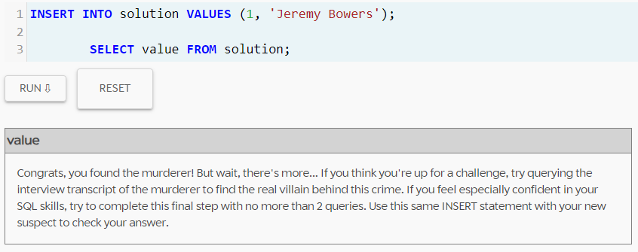
Murderer!
The investigation done based on the details given by Morty Schapiro point out to the Person named
Lets check if the finding is right.
“Jeremy Bowers “

Slide 9
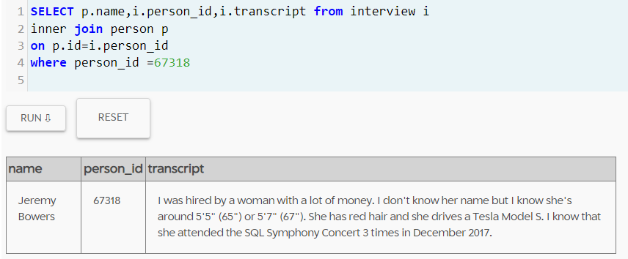
Finding the Real VILLAIN
Need to check the interview statement given by the murderer…
Interview statement: I was hired by a woman with a lot of money. I don't know her name but I know she's around 5'5" (65") or 5'7" (67"). She has red hair and she drives a Tesla Model S. I know that she attended the SQL Symphony Concert 3 times in December 2017.

Slide 10
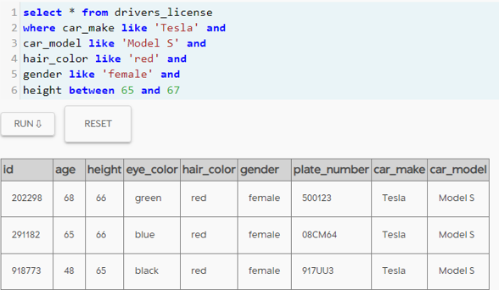
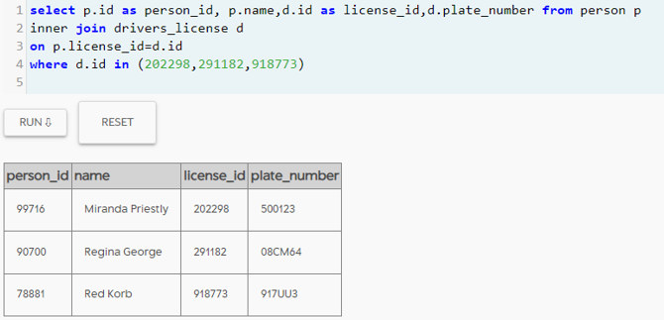
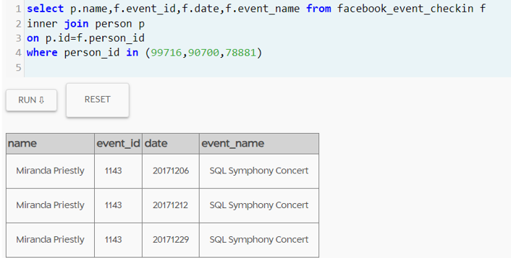

Slide 11
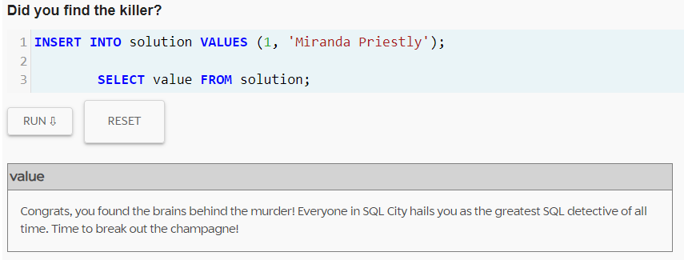
Brain behind Murder
After investigating the person table, driving license table & Facebook event table found out a woman named could be the brain behind the murder.
Lets check the result…
“Miranda Priestly”

Slide 12
MISTRY SOLVED

